Slide 1
Chapter 9
Acids, Bases, and Buffers in the Body
Acids and Bases—Definitions
Strong Acids and Bases
Chemical Equilibrium
Weak Acids and Bases
pH and the pH Scale
pK_{a}
Amino Acids: Common Biological Weak Acids
Buffers: An Important Property of Weak Acids and Bases

Slide 2
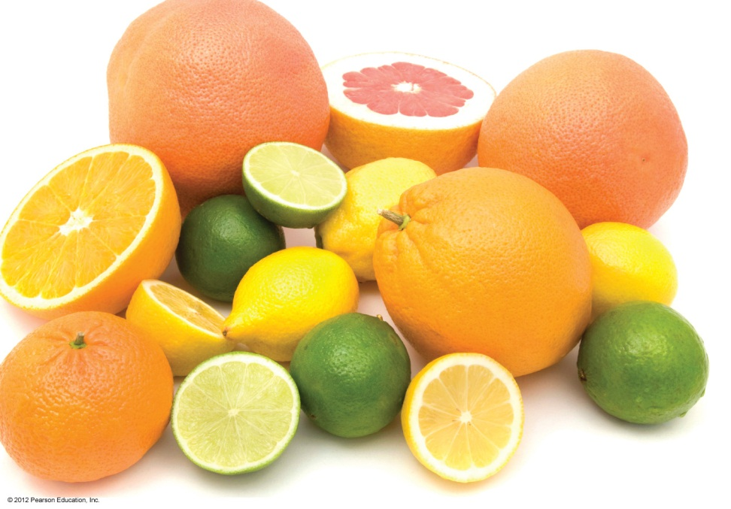
Acids
Arrhenius acids
produce H⁺ ions in water
H₂O(l)
HCl(g) → H⁺(aq) + Cl⁻(aq)
are electrolytes
have a sour taste
turn litmus red
neutralize bases

Slide 3
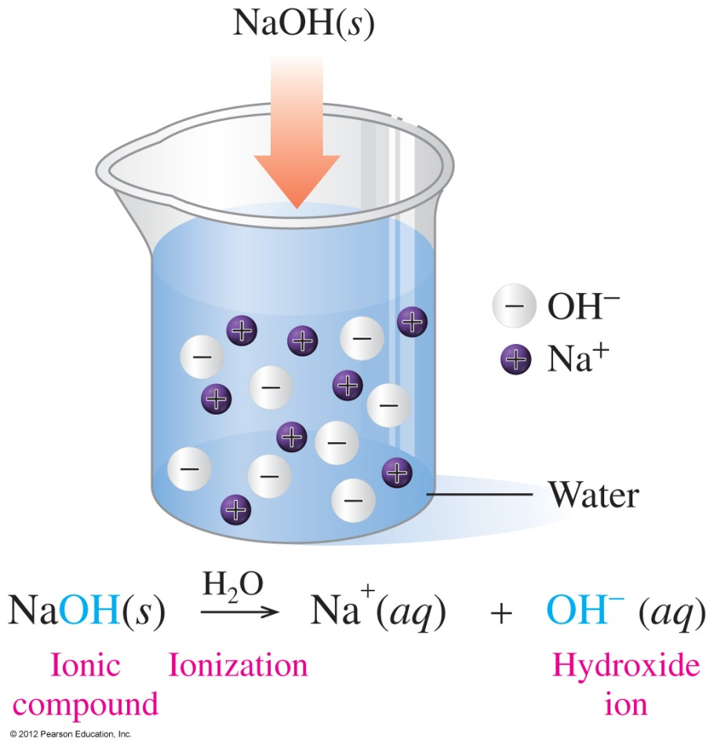
Bases
Arrhenius bases
produce OH⁻ ions in water
taste bitter or chalky
are electrolytes
feel soapy and slippery
neutralize acids

Slide 4
Practice
Identify each as a characteristic of an
A. acid or B. base.
____1. has a sour taste
____2. produces OH⁻ in aqueous solutions
____3. has a chalky taste
____4. is an electrolyte
____5. produces H⁺ in aqueous solutions

Slide 5
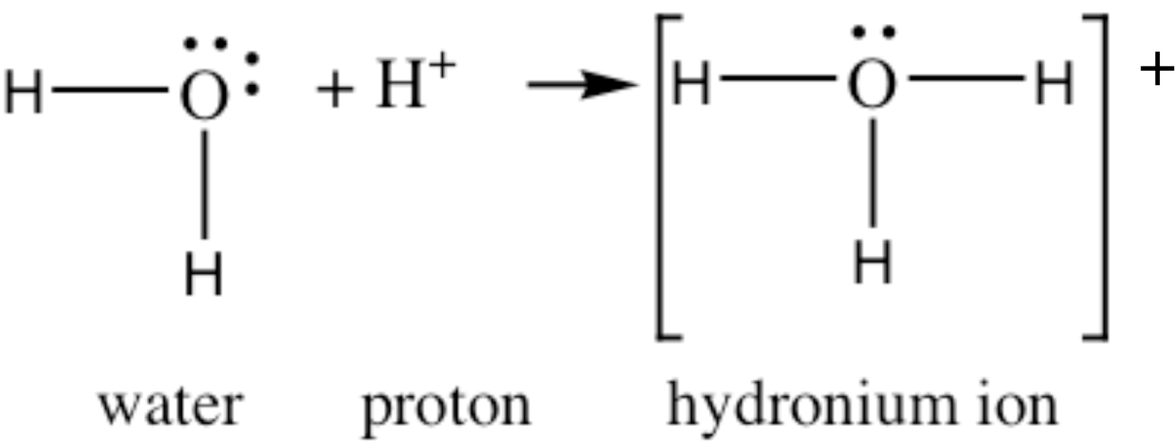
Brønsted–Lowry Acids and Bases
According to the Brønsted–Lowry theory,
acids donate a proton (H⁺)
bases accept a proton (H⁺)

Slide 6
NH₃, a Brønsted–Lowry Base
In the reaction of ammonia and water,
NH₃ is the base that accepts H⁺
H₂O is the acid that donates H⁺

Slide 7
Practice
In each of the following identify the Brønsted–Lowry acid and base:
A. HNO₃(aq) + H₂O(l) → H₃O⁺(aq) + NO₃⁻(aq)
B. HF(aq) + H₂O(l) H₃O⁺ (aq) + F⁻(aq)

Slide 8
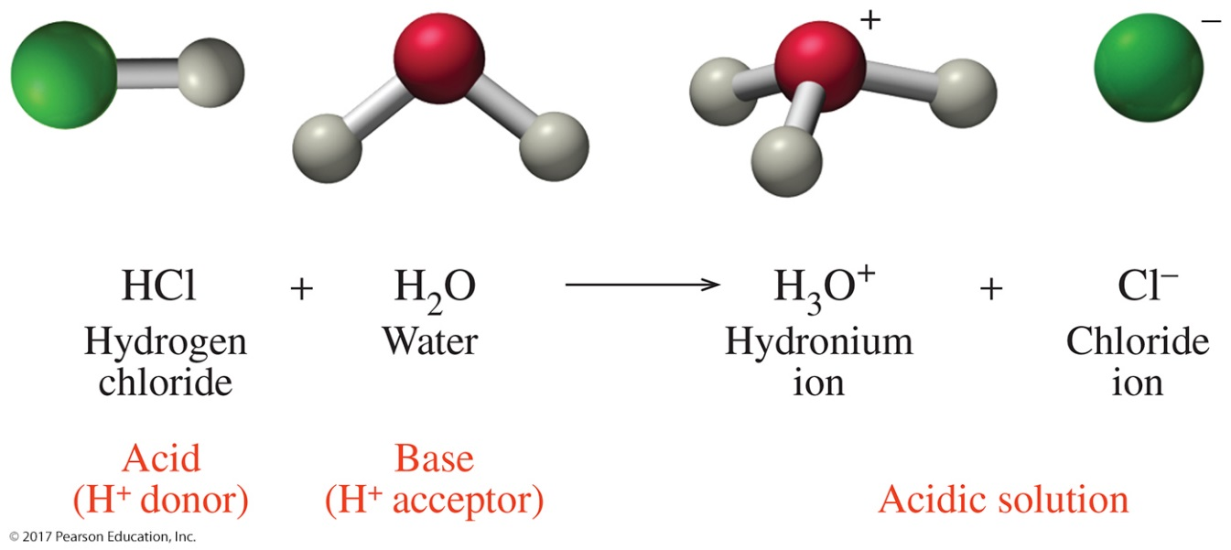
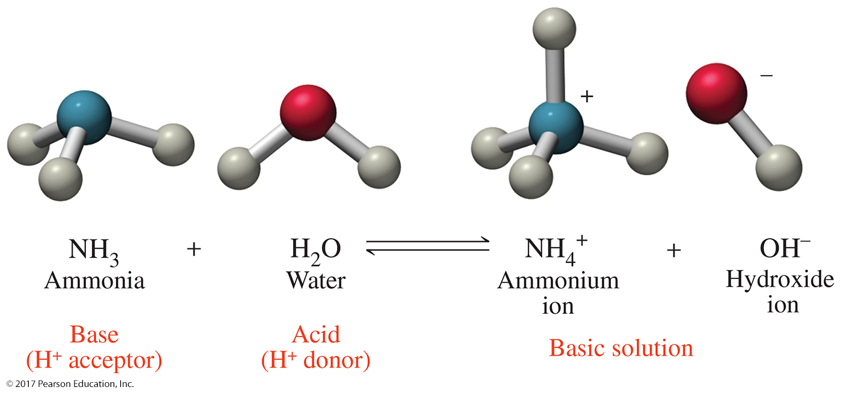
Water can act as an acid or a base by donating or accepting a proton.

Slide 9
Naming Acids
Acids with H and a nonmetal are named with the prefix hydro and end with ic acid.
HCl hydrochloric acid
Acids with H and a polyatomic ion are named by changing the end of the name of the polyatomic ion from
ate to ic acid or
ite to ous acid
ClO₃⁻ chlorate HClO₃ chloric acid
ClO₂⁻ chlorite HClO₂ chlorous acid

Slide 10
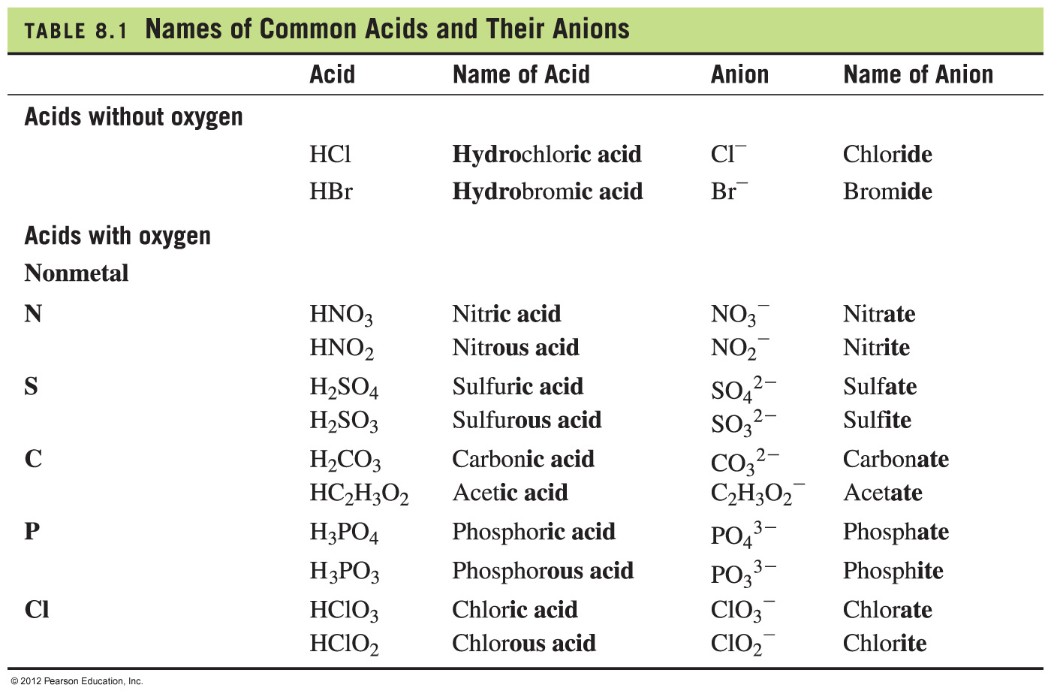
Names of Common Acids

Slide 11
Common Strong Acids and Bases
Common Strong Acids
Hydrochloric acid HCl _{(aq)}
Hydrobromic acid HBr _{(aq)}
Hydroiodic acid HI _{(aq)}
Perchloric acid HClO_{4 (aq)}
Chloric acid HClO_{3 (aq)}
Nitric acid HNO_{3 (aq)}
Sulfuric acid H₂SO_{4 (aq)}
Strong acids completely dissociate in water, forming hydronium ions and anions.
Common Strong Bases
Lithium hydroxide LiOH _{(aq)}
Sodium hydroxide NaOH _{(aq)}
Potassium hydroxide KOH _{(aq)}
Strontium hydroxide Sr(OH)₂ _{(aq)}
Barium hydroxide Ba(OH)₂ _{(aq)}
Calcium hydroxide Ca(OH)_{2 (aq)}
Strong bases completely dissociate in water, forming hydroxide ions and cations

Slide 12
Practice
Match the formulas with the names.
1. ___HNO₂ A. iodic acid
2. ___Ca(OH)₂ B. sulfuric acid
3. ___H₂SO₄ C. sodium hydroxide
4. ___HIO₃ D. nitrous acid
5. ___NaOH E. calcium hydroxide

Slide 13
Acids
A strong acid completely ionizes (100%) in aqueous solutions.
HCl(g) + H₂O(l) → H₃O⁺(aq) + Cl⁻(aq)
A weak acid dissociates only slightly in water to form a few ions in aqueous solutions.
H₂CO₃(aq) + H₂O(l) H₃O⁺(aq) + HCO₃⁻(aq)

Slide 14
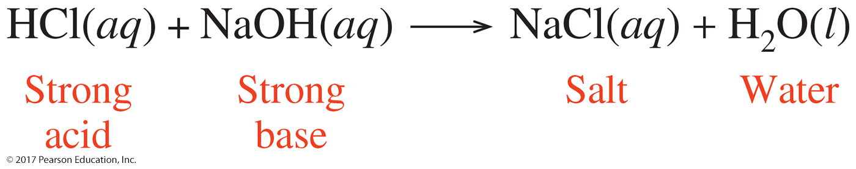
Neutralization
The reaction of a strong acid and strong base always produces water and a salt.
This reaction is called neutralization.
© 2017 Pearson Education, Inc.

Slide 15
Conjugate Acid–Base Pairs
In any acid–base reaction, there are two conjugate
acid–base pairs.
Each pair is related by the loss and gain of H⁺.
One pair occurs in the forward direction.
One pair occurs in the reverse direction.
conjugate acid–base pair 1
HA + B A⁻ + BH⁺
conjugate acid–base pair 2

Slide 16
Practice
1. Write the conjugate base of each of the following:
A. HBr
B. H₂S
C. H₂CO₃
2. Write the conjugate acid of each of the following:
A. NO₂⁻
B. NH₃
C. OH⁻

Slide 17
Practice
Identify the sets that contain acid–base conjugate pairs.
1. HNO₂, NO₂⁻
2. H₂CO₃, CO₃²⁻
3. HCl, ClO₄⁻
4. HS⁻, H₂S
5. NH₃, NH₄⁺

Slide 18
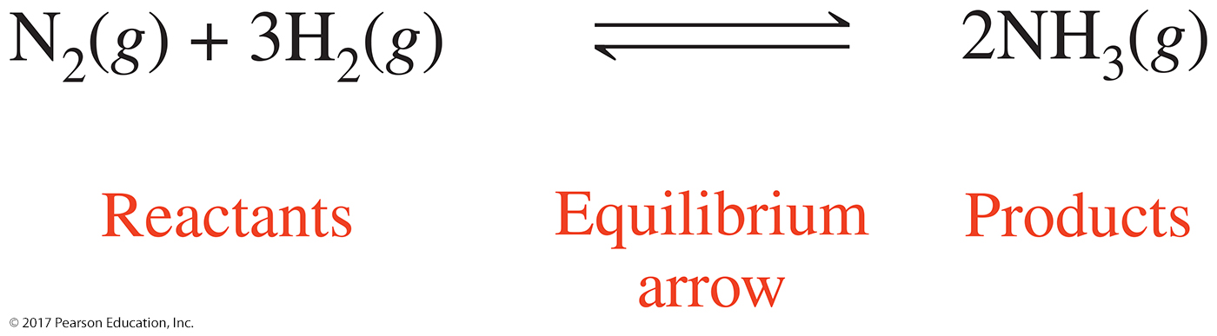
Chemical Equilibrium
A reversible reaction proceeds in both the forward and
reverse directions. As a result there are two reaction
rates: the rate of the forward reaction and the rate of the
reverse reaction.
When molecules begin to react, the rate of the forward reaction is faster than the rate of the reverse reaction.
As reactants are consumed and products accumulate, the rate of the forward reaction decreases, whereas the rate of the reverse reaction increases.

Slide 19
Practice
Complete with equal, not equal, forward, reverse,
changes, or does not change.
1. Reactants form products in the ________ reaction.
2. At equilibrium, the reactant concentration _______.
3. When products form reactants, it is the _______ reaction.
4. At equilibrium, the rate of the forward reaction is ______ to the rate of the reverse reaction.
5. If the forward reaction is faster than the reverse, the amount of products ________.

Slide 20

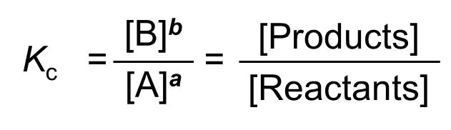
Equilibrium Constants
For the reaction,
the equilibrium constant expression, K_{c}, gives the concentrations of the reactants and products at equilibrium,
the square brackets indicate the moles/liter of each substance, and
the coefficients b and a are written as superscripts that raise the moles/liter to a specific power.

Slide 21
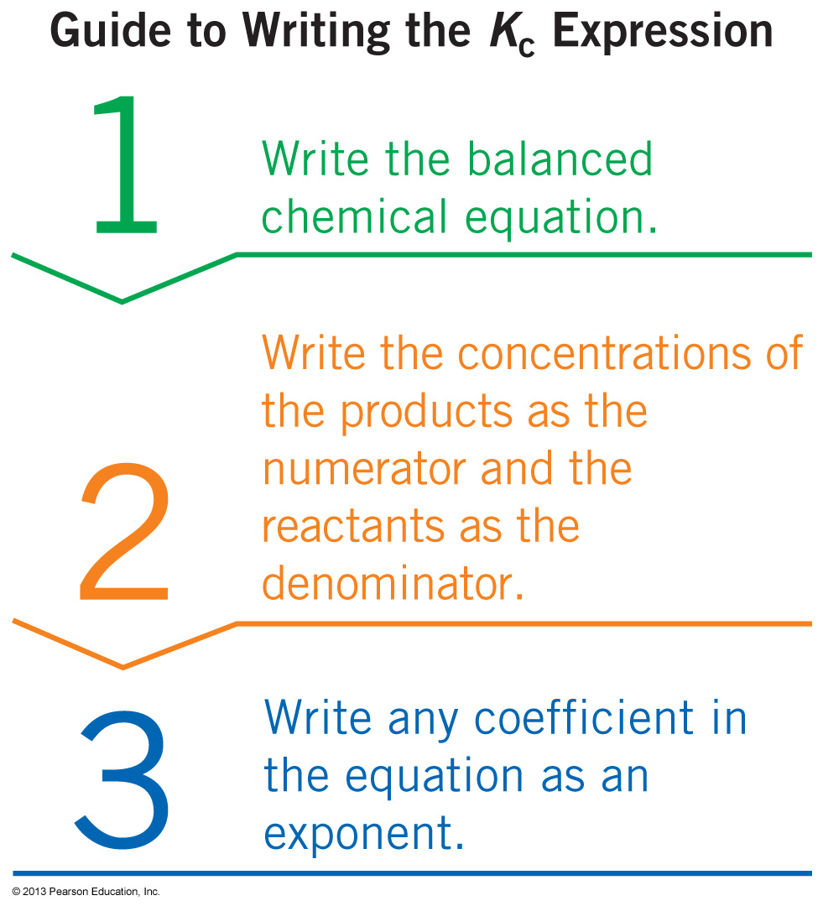
Guide to Writing the K_{c} Expression

Slide 22
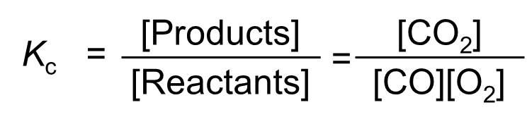


Writing a K_{c} Expression
Write the K_{c} expression for the following reaction.
${CO\left(g\right)+O}_{2 }(g) ↔{CO}_{2}(g)$
Step 1 Write the balanced chemical equation.
${2 CO\left(g\right)+O}_{2 }\left(g\right)↔{2 CO}_{2}\left(g\right)$
Step 2 Write the concentrations of the products as the numerator and the reactants as the denominator.
Step 3 Write any coefficient in the equation as an exponent.
$$K_{c}=\frac{{\left[{CO}_{2}\right]}^{2}}{{\left[CO\right]}^{2}\left[O_{2}\right]}$$

Slide 23
Practice
Write the K_{c} expression for the reaction shown below?

Slide 24
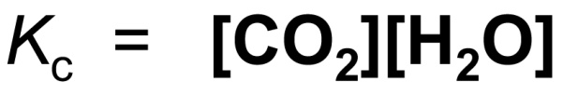
Homogeneous, Heterogeneous Equilibrium
In a homogeneous equilibrium, all reactants and products in the reaction are in the same physical state.
In a heterogeneous equilibrium, the reactants and products are in two or more physical states.
The concentration of solids and liquids are constant,
and therefore omitted from the equilibrium constant
expression.

Slide 25
Practice
Write the equilibrium constant expression for the
following reaction at equilibrium.

Slide 26
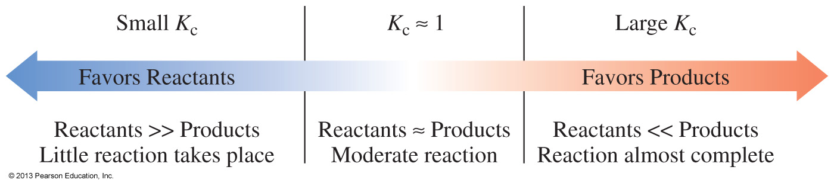
Summary of K_{c} Values
Solids (s) and pure liquids (l) have constant concentrations, so they do not appear in the equilibrium expression.
A reaction
that favors products has a large K_{c}.
with about equal concentrations of products and reactants has a K_{c} close to 1.
that favors reactants has a small K_{c}.

Slide 27
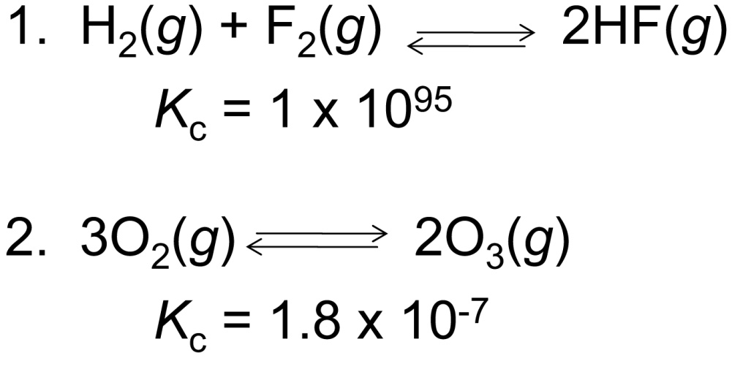
Practice
For each K_{c}, indicate whether the reaction at equilibrium
contains mostly reactants or products.

Slide 28
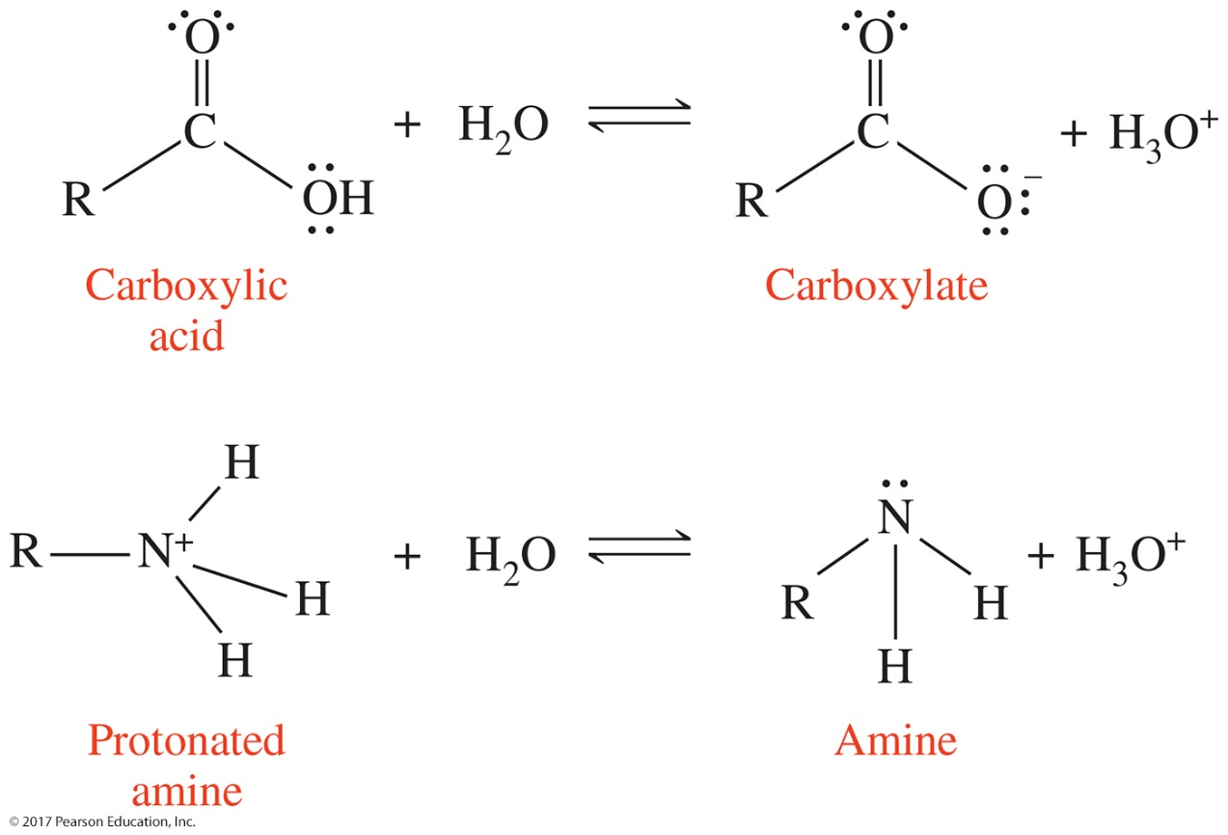
All weak acids dissociate by donating a proton to form a hydronium ion. Each weak acid has an acid dissociation constant, or K_{a.}
The larger the K_{a}, the stronger the acid.
© 2017 Pearson Education, Inc.

Slide 29
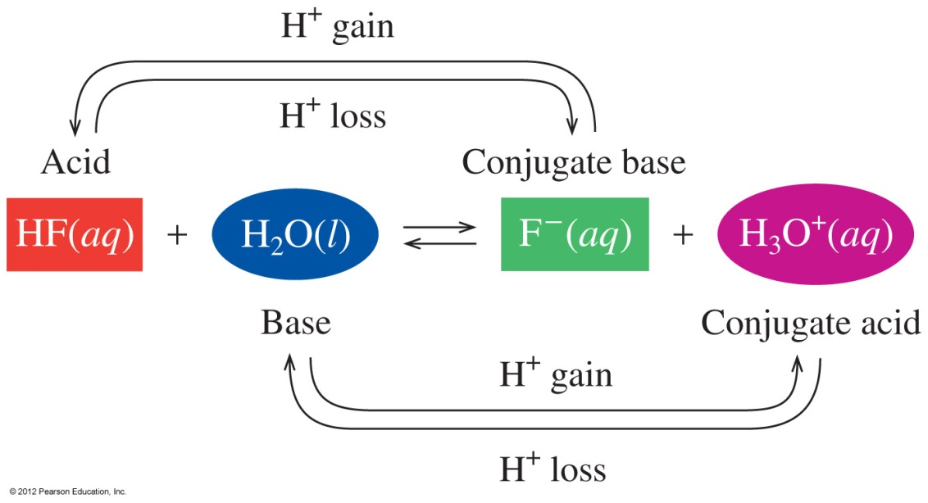
Conjugate Acid–Base Pairs
In this acid–base reaction,
an acid, HF, donates H⁺ to form its conjugate base, F⁻
a base, H₂O, accepts H⁺ to form its conjugate acid, H₃O⁺
there are two conjugate acid–base pairs

Slide 30

Conjugate Acid–Base Pairs
In this acid–base reaction,
the first conjugate acid–base pair is HF, which donates H⁺ to form its conjugate base, F⁻
the other conjugate acid–base pair is H₂O, which accepts H⁺ to form its conjugate acid, H₃O⁺
each pair is related by a loss and gain of H⁺

Slide 31
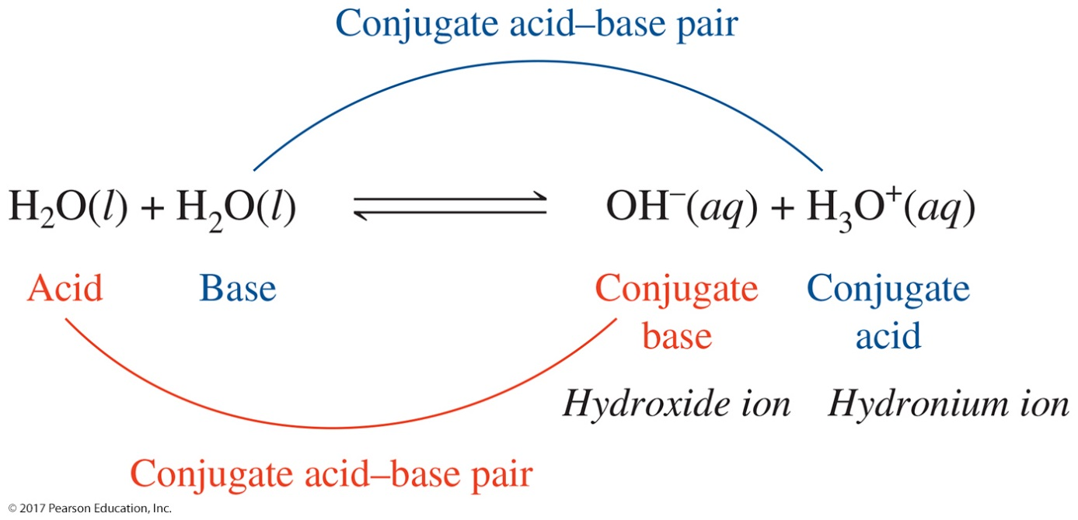
Ion Product of Water, K_{w}
The ion product constant, K_{w}, for water
is the product of the concentrations of the hydronium and hydroxide ions
K_{w} = [H₃O⁺] [OH⁻]
can be obtained from the concentrations in pure water
K_{w} = [H₃O⁺] [OH⁻]
K_{w} = [1.0 × 10⁻⁷ M] × [1.0 × 10⁻⁷ M]
= 1.0 × 10⁻¹⁴

Slide 32
Calculating pH of Solutions
pH is the negative log of the hydronium ion concentration.
pH = −log [H₃O⁺]
Example: For a solution with [H₃O⁺] = 1 × 10⁻ ⁴
    pH = −log [1 × 10⁻ ⁴ ]
    pH = −[−4.0]
    pH = 4.0
Note: The number of decimal places in the pH equals
the significant figures in the coefficient of [H₃O⁺].
4.0 1 SF: 1 × 10⁻⁴

Slide 33
The pH Scale
The pH of a solution
is used to indicate the acidity of a solution
has values that usually range from 0 to 14
is acidic when the values are less than 7
is neutral with a pH of 7
is basic when the values are greater than 7

Slide 34
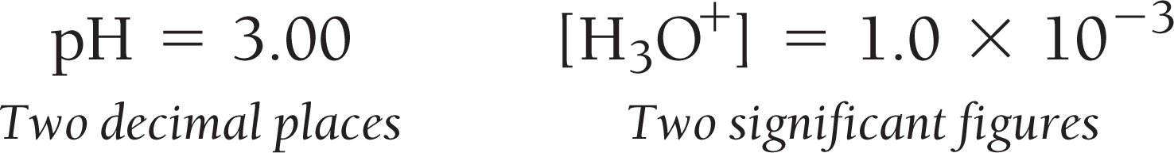
pH and the pH Scale, Continued
Solving the equation for [H₃O⁺], we have:
INV log (-) pH = [H₃O⁺]
or alternatively,
10^{-pH} = [H₃O⁺]
The number of significant figures in the [H₃O⁺] is:

Slide 35
Practice
Complete the following table
[H₃O⁺] | [OH⁻] | pH | pOH | Acidic/Basic?
1.0 x 10⁻⁹ M
 | 4.1x10⁻² M
 |  | 3.75
 |  |  | 5.45

Slide 36
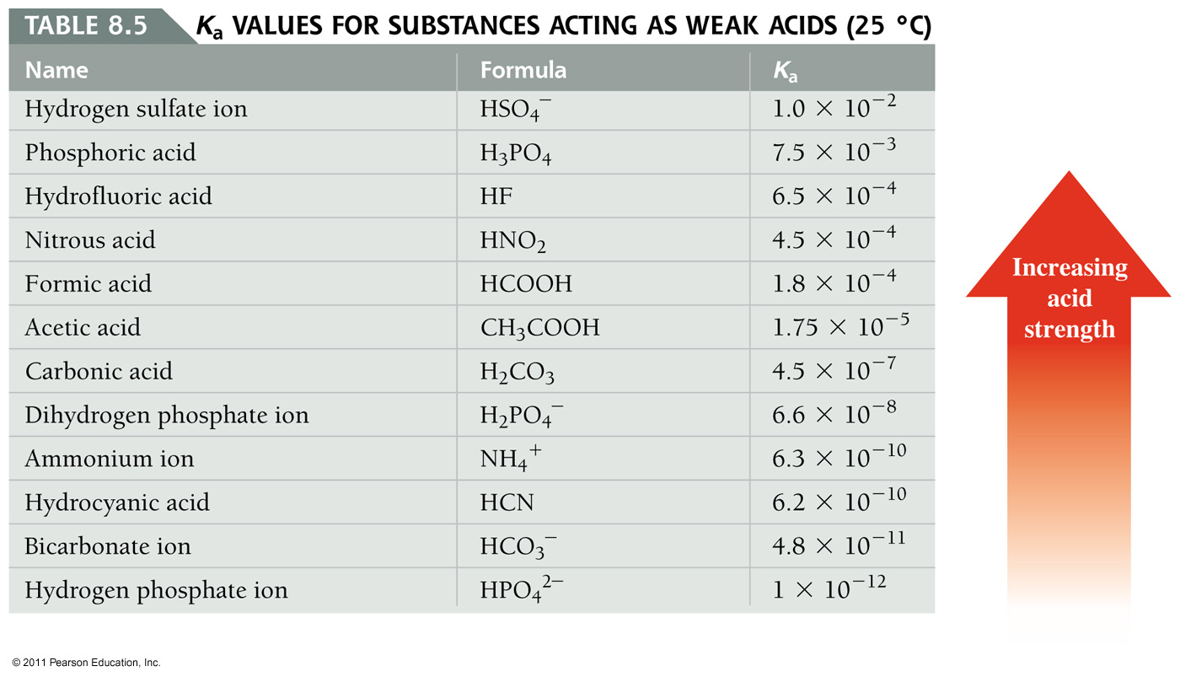
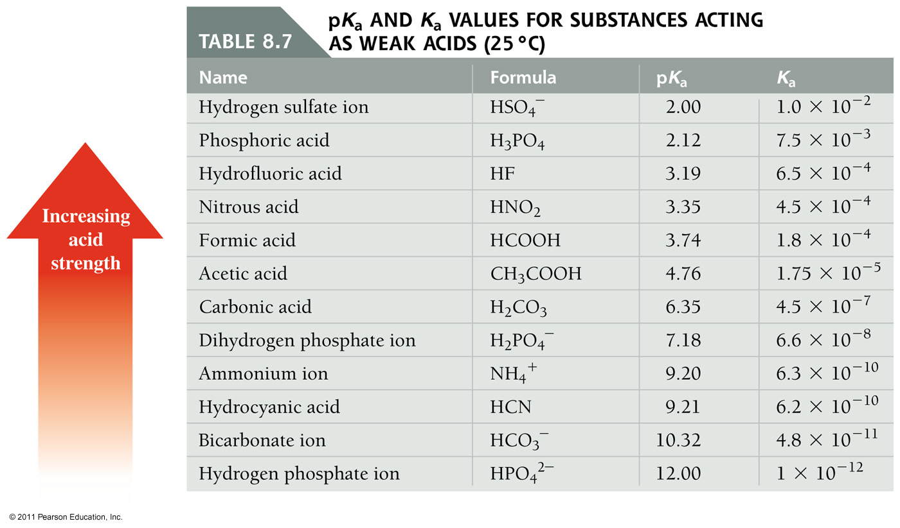
K_{a} and pK_{a}
pK_{a} = - log K_{a}
Those K_{a} values closer to 1 are the stronger acids. The pK_{a} values for the stronger acids are low.

Slide 37
Le Châtelier’s Principle
Chemical equilibrium can be disturbed by a change in
concentration, volume, or temperature. Altering any of
these conditions puts the system under stress.
Le Châtelier’s principle states that
when a system at equilibrium is disturbed, the system will shift in the direction that will reduce that stress.
there will be a change in the rate of the forward or reverse reaction to return the system to equilibrium.

Slide 38
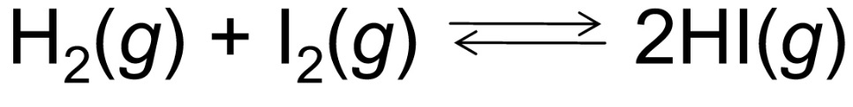
Changing Concentrations
For the following reaction at equilibrium,
the rate of the forward reaction is increased to relieve the stress when more H₂ or I₂ is added, or HI is removed.
the rate of the reverse reaction is increased to relieve the stress when H₂ or I₂ is removed or more HI is added.

Slide 39
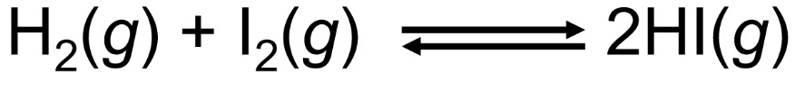
Adding Reactant or Product
The equilibrium shifts toward
products when H₂(g) or I₂(g) is added.
reactants when HI(g) is added.
Add H₂ or I₂
Add HI

Slide 40

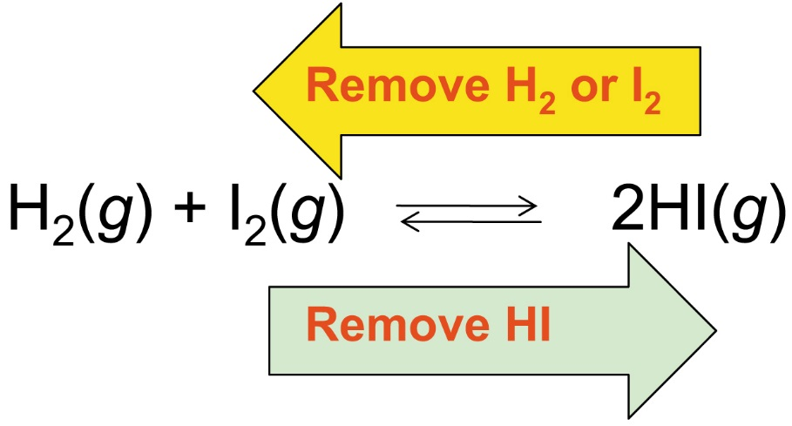
Removing Reactant or Product
The system shifts toward
a reverse reaction when H₂ or I₂ is removed.
a forward reaction when HI(g) is removed.

Slide 41
Practice
Predict any shift in the forward or reverse reactions for
each of the following changes on the reaction.
1. H₂S(g) is added.
2. NH₃(g) is removed.
3. A catalyst is added.

Slide 42
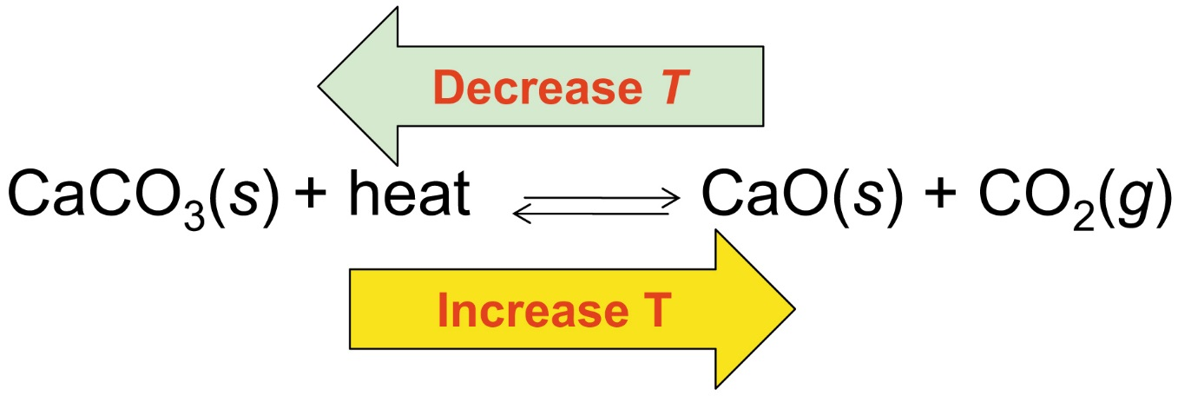
Temperature Change and Endothermic Reactions
For an endothermic reaction at equilibrium, heat is a
reactant.
A decrease in temperature (T) removes heat, shifting the equilibrium toward the reactants.
An increase in temperature adds heat, shifting the equilibrium toward the products.

Slide 43
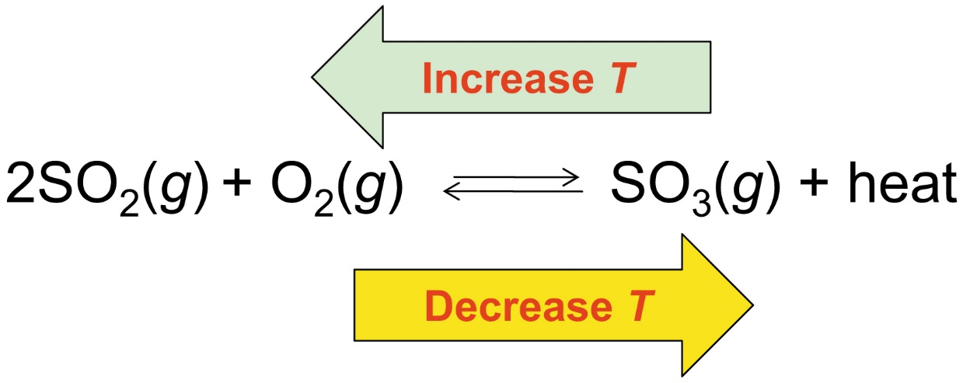
Temperature Change and Exothermic Reactions
For an exothermic reaction at equilibrium,
an increase in temperature adds heat and the equilibrium shifts toward the reactants.
a decrease in temperature (T) removes heat and the equilibrium shifts toward the products.

Slide 44
Practice
Indicate if each change on a reaction at equilibrium shifts
towards the products or reactants or does not change the
equilibrium.
1. adding NO(g)
2. raising the temperature

Slide 45
The Relationship between pH and pK_{a}
pH and pK_{a} are two numbers associated with weak acid solutions.
pK_{a} gives us the fraction of acid molecules that will dissociate, that is, pK_{a} gives the ratio of conjugate base and hydronium ion to weak acid.
pH tells how much hydronium ion is present in solution.

Slide 46
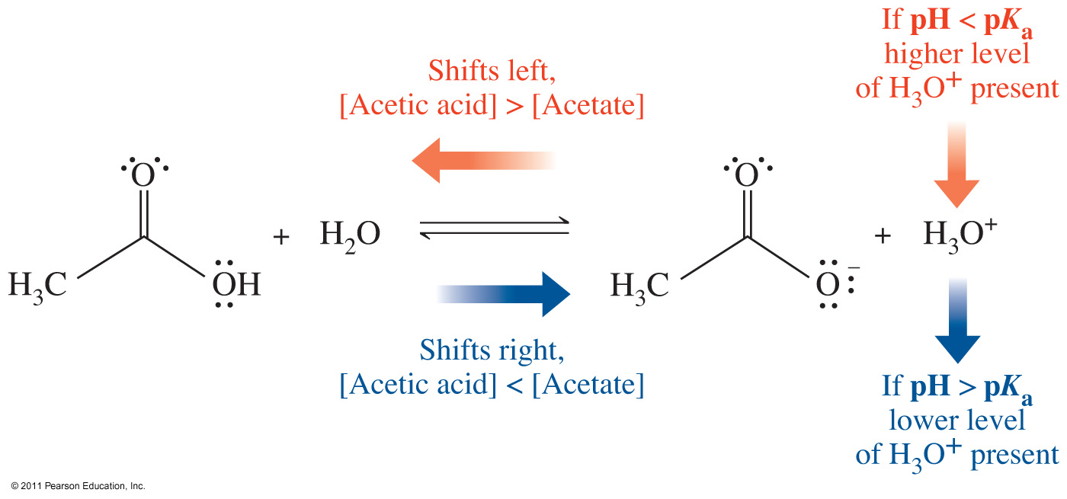
At constant temperature, pK_{a} does not change if an acid or a base is added to a weak acid solution
The pH does change if an acid or a base is added to a weak acid solution.
Consider an acetic acid solution at three different pH’s:
    A pH below the pK_{a}
    A pH equal to pK_{a}
    A pH above the pK_{a}

Slide 47
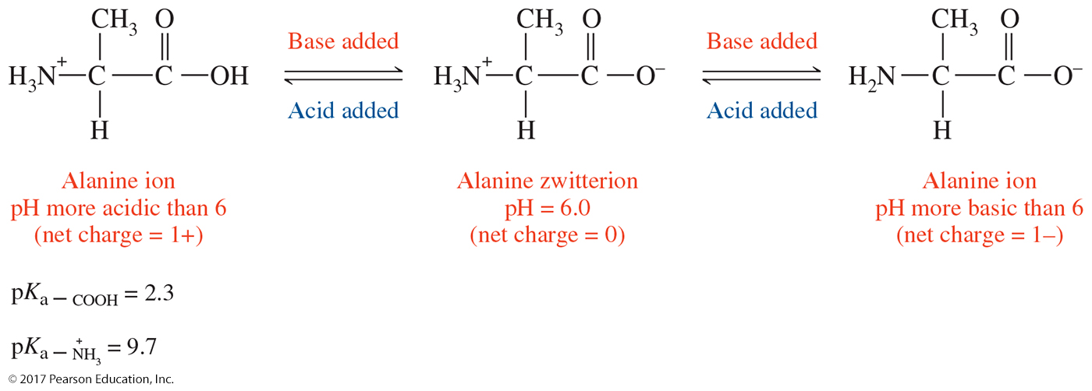
Isoelectric Points for Amino Acids
Because the amine group is basic, and the carboxylic acid group is acidic, amino acids often exist as zwitterions
A zwitterion is a dipolar ion with a net charge of zero
The isoelectric point (pI) is the pH at which a zwitterion forms

Slide 48
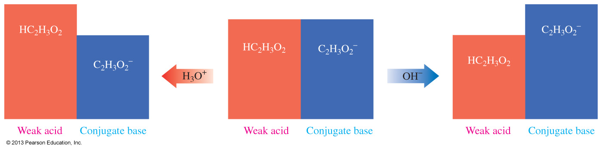
Buffers
A buffer is a solution that contains both a weak acid and its conjugate base, or a base and its conjugate acid.
A buffer will resist a change in pH if small amounts of an acid or a base are added.

